Slide 1
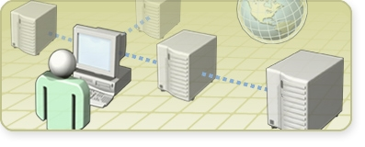
First Look: Getting Started with the 2007 Microsoft Office System
Clinic 3199B

Slide 2

Introduction
Name
Company affiliation
Title/function
Job responsibility
Networking experience
Windows SharePoint Services experience
Microsoft Office System experience
Expectations for the clinic

Slide 3
Clinic Materials
Clinic evaluation

Slide 4
Prerequisites
Microsoft Office system technologies
Windows client and server operating systems
Experience installing, configuring, and supporting Microsoft Office technologies
Working knowledge of Windows
SharePoint Services 2.0

Slide 5
Clinic Outline
Session 1: Benefits of Deploying the
2007 Office System
Session 2: Overview of the 2007 Microsoft Office
System Components

Slide 6

Microsoft Learning
HOL 3372: Getting Started with the 2007 Microsoft Office System
Clinic 3369: First Look: Getting Started with Windows SharePoint Services 3.0
Clinic 3370: First Look: Getting Started with Microsoft Office SharePoint Server 2007
http://www.microsoft.com/learning/

Slide 7
Microsoft Learning Product Types
Microsoft Official Course
Lecture
Activity
Traditional classroom presentation that combines lecture with guided activities to prepare you for a new job or new Microsoft technology
Microsoft Official Workshop
Lecture
Activity
Experienced with the technology? Learn a skill or function through instructor-facilitated activities and self-directed study
Microsoft Official Clinic
Lecture
Demo
How to use a Microsoft product or feature for a specific business problem
Microsoft Official Seminar
Lecture
How a Microsoft product can solve your business problems

Slide 8

Microsoft Certified Professional Program
http://www.microsoft.com/learning/

Slide 9

Facilities
Class hours
Building hours
Parking
Restrooms
Meals
Phones
Messages
Smoking
Recycling

